Slide 1
LAB 2 – SWITCH

Slide 2
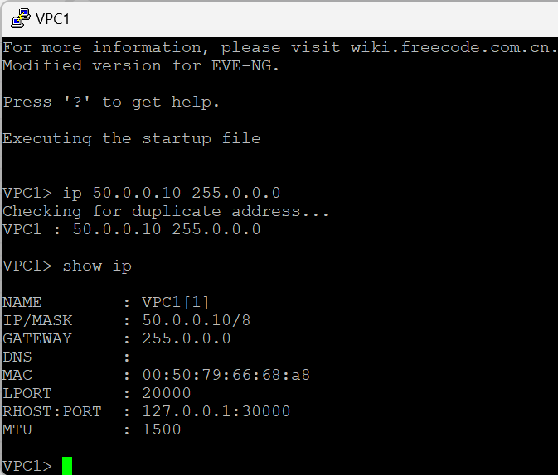
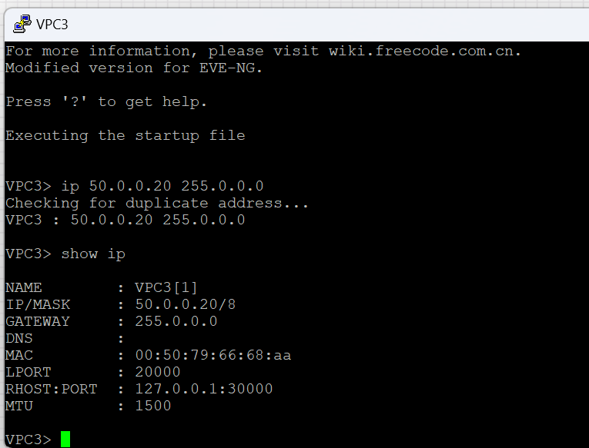

Slide 3
